Slide 1
Democratic Competition II: Party Systems
POL1036: Comparative European Politics – Lecture 11 & 12
09 & 12/03/2026

Slide 2
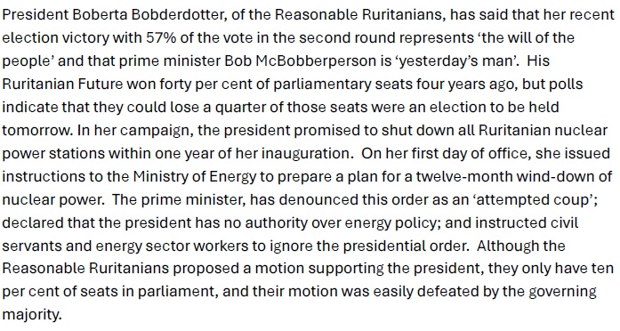
Recap: Cohabitation and the primacy of parties in parliamentary democracy
Example of inter-executive conflict based on the PM and the president being from different parties (Cohabitation)
Clear dual democratic legitimacy
We cannot understand parliamentary democracy without parties

Slide 3
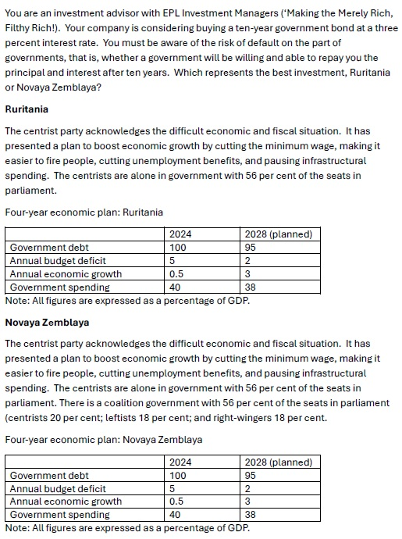
Recap: Parties as Veto-Players
NZ: more veto-players
More actors who need to agree
Less likely to change status quo (Tsebelis)
More veto-players:
Pro: Commitment to SQ is more credible
Contra: Less flexibility to react to change

Slide 4
Parliament & Government are like two machines driven by the same motor – the party. Maurice Duverger (1954: 46) about the UK

Slide 5
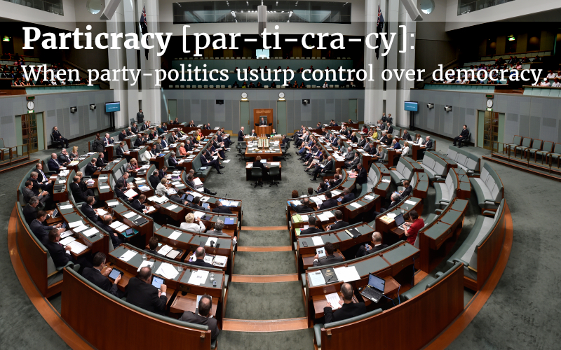
Parties dominate parliaments...
MPs are committed to parties
Parties support government
Transparent voting leads to high party discipline
Professionalization makes MPs dependent on their party
… & Governments
Compiled by parties
Can put pressure on government

Slide 6
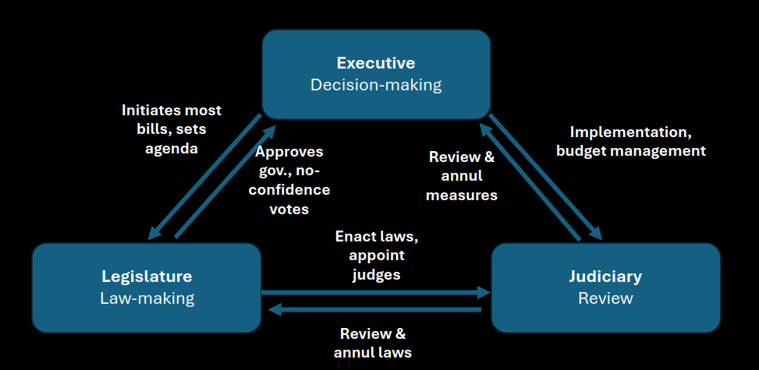
Institutions
Parliament & Government
Electoral system
Seeking Office
Individuals
Voters
Vote based on political culture
Groups
Parties
Seeking Votes
Democratic Competition

Slide 7
Parties are categorized along their origin and ideologies into party families, most of which are represented in almost every country's party system.

Slide 8
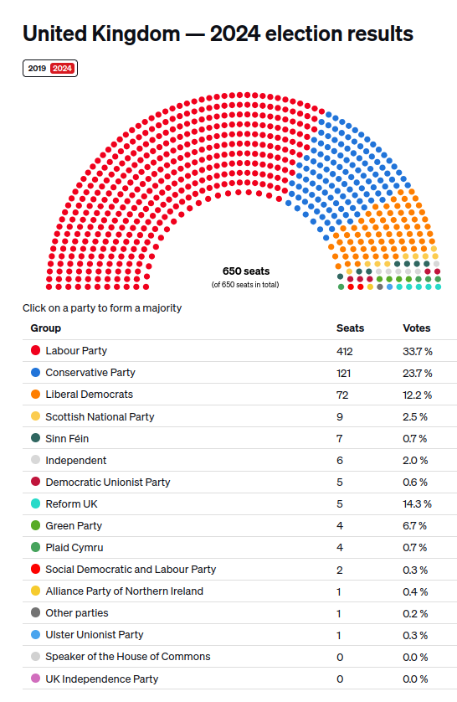

What defines a party system? (Sartori, 1976)
Fragmentation
#Parties
Just count the parties?
Instead: Effective number
Of Elective Parties (ENEP, votes)
Of Parliamentary Parties (ENPP, seats)
1 divided by sum of proportion of votes/seats of each party squared

Slide 9
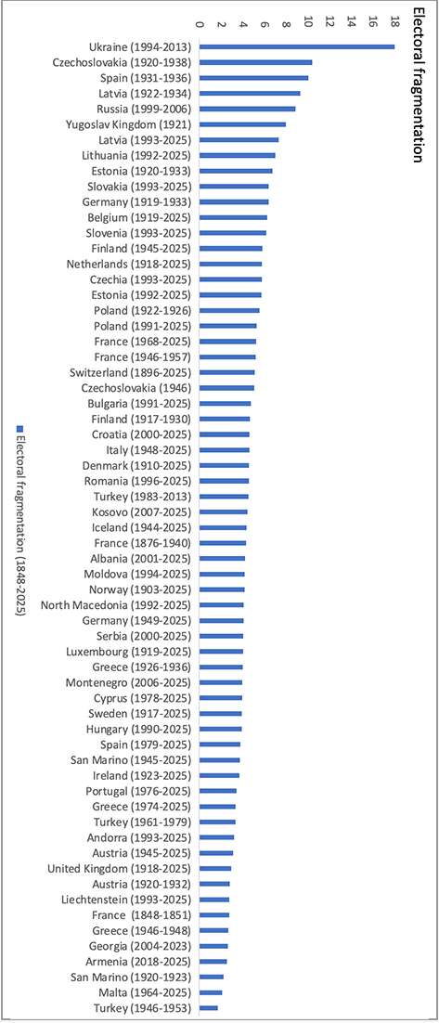
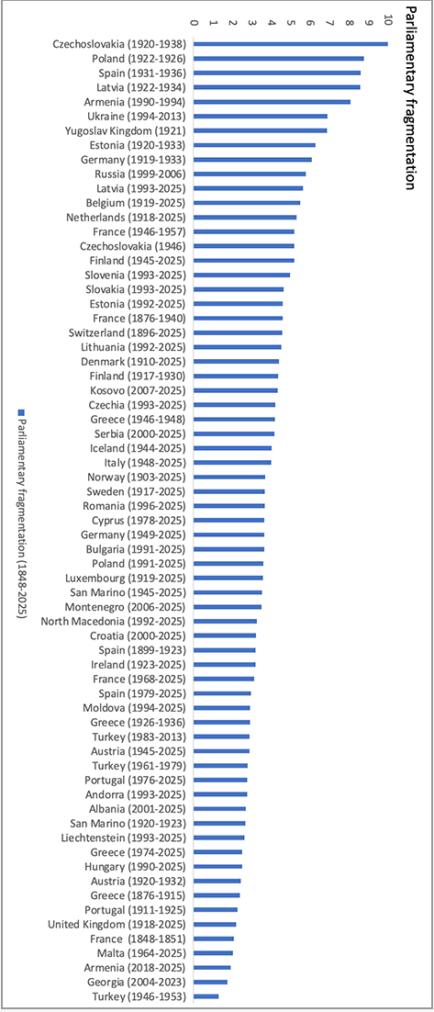
ENEP
ENPP
https://whogoverns.eu/party-systems/effective-number-of-parties/

Slide 10
What defines a party system? (Sartori, 1976)
Fragmentation
#Parties
Polarization
Ideological distance
Just count the parties?
Instead: Effective number
Of Elective Parties (ENEP, votes)
Of Parliamentary Parties (ENPP, seats)
1 divided by sum of proportion of votes/seats of each party squared
Many different iterations
Sartori: % of votes by anti-establishment parties
Self-perception of challenger to establishment
States it is different from establishment
Challenges policy and systemic status quo

Slide 11
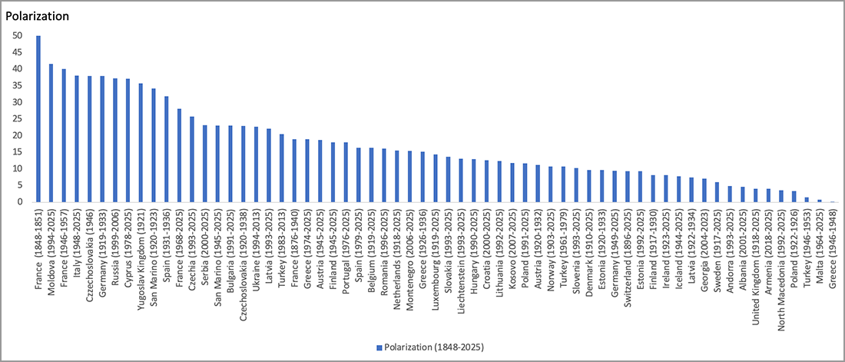
https://whogoverns.eu/party-systems/polarization/

Slide 12
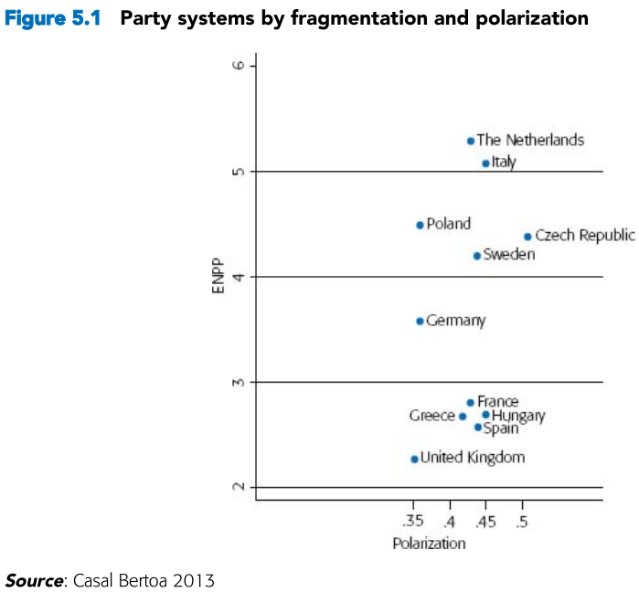
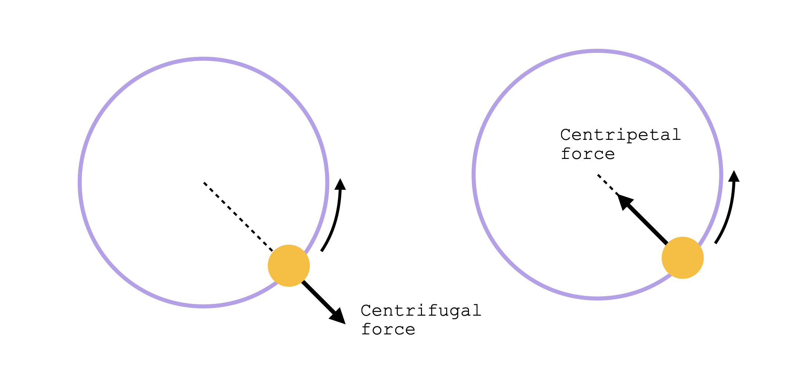
Synthesizing Fragmentation & Polarization
Effects on Competition?
M2P/MMP: centripetal competition
PMP: centrifugal competition
But: Simplistic!
Polarized multi-partyism
Moderatemulti-partyism
Moderate two-partyism
Bale (2017: 272)

Slide 13
Recap: 4 + 3 main democratic ideologies
Views about state intervention in society & economy
Christian Democracy
Conservatism
Social Democract / Socialism
Left
Liberalism
Right
Green political though, nationalism, populism?

Slide 14
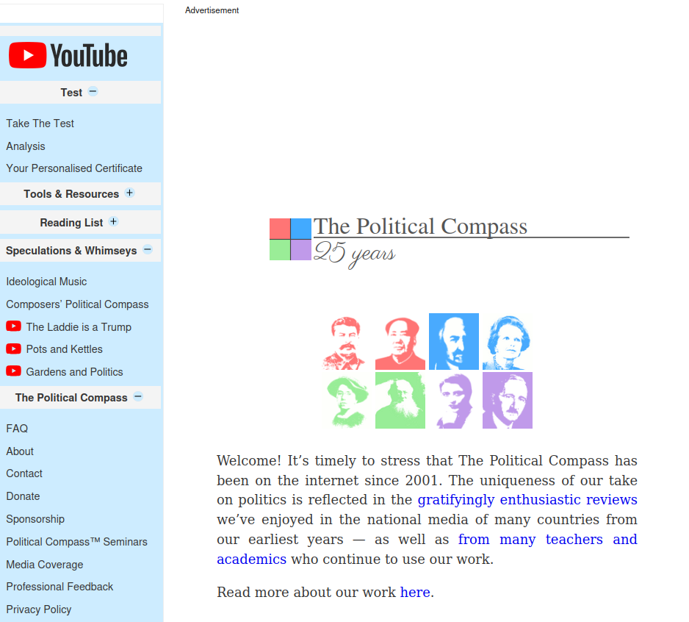
What is your ideology?
Politicalcompass.org - 6 pages – note your position on the grid

Slide 15
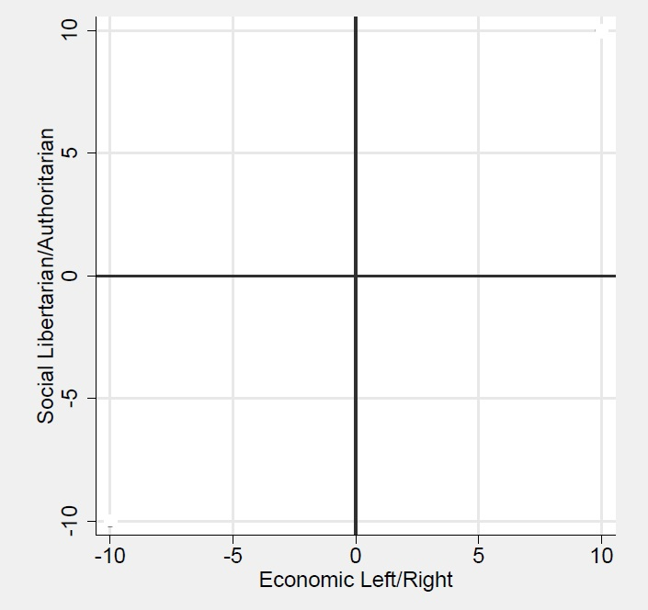
Recap: Left-Right vs GAL-TAN
Social/GAL-TAN: values related to social and cultural issues
GAL: Green, Alternative, Libertarian -> personal freedoms; civil liberties, same-sex marriage, a greater role for citizens in governing
TAN: Traditional, Authoritarian and Nationalist -> law and order; tradition; the belief that the government should be a strong moral authority
Economic/Left-Right: Involvement of state in society
Extreme left: large public sector, planned economy, redistribution, …
Extreme right: private property, capitalism, ...

Slide 16
But GAL-TAN has issues
Are Green, Alternative and Libertarian similar, and opposite to Traditional, Authoritarian and Nationalist?
Does Green have a clear opposite among Traditional, Authoritarian and Nationalist?
Does Nationalist have a clear opposite among Green, Alternative and Libertarian?
Result of trying to fit social and cultural attitudes on a single scale

Slide 17
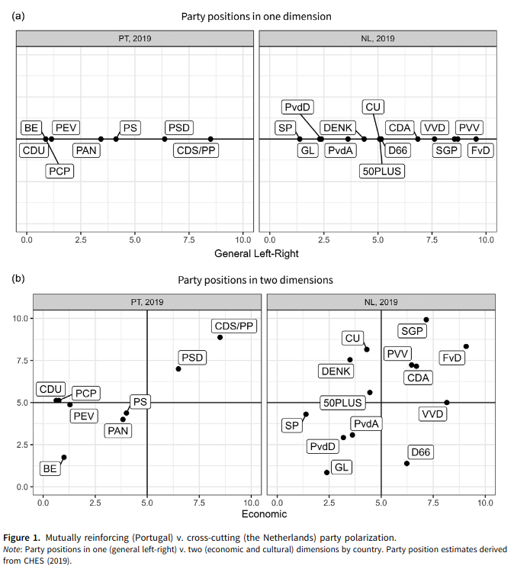
Koedam J, Binding G, Steenbergen MR. Multidimensional Party Polarization in Europe: Cross-Cutting Divides and Effective Dimensionality. British Journal of Political Science. 2025.

Slide 18
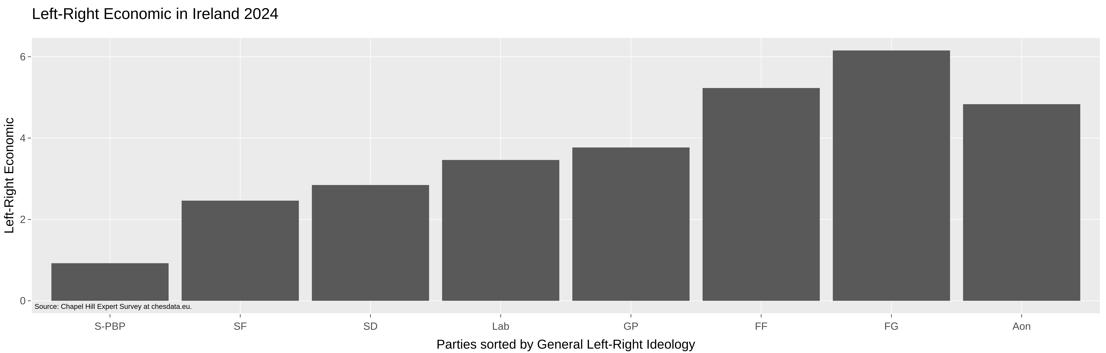
Ireland?
https://www.chesdata.eu/ches-europe

Slide 19
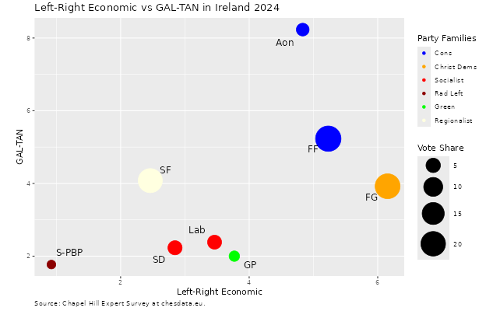
Ireland?
https://www.chesdata.eu/ches-europe

Slide 20
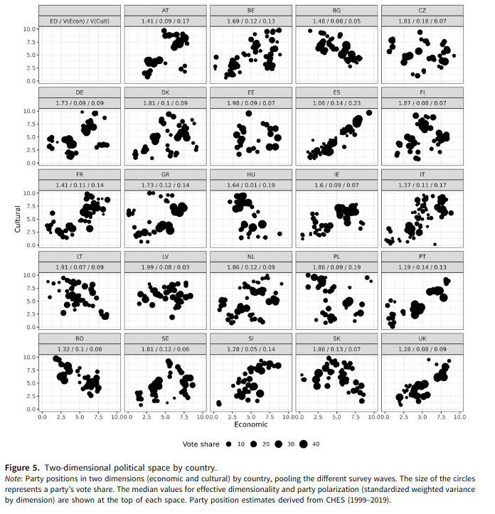
Koedam J, Binding G, Steenbergen MR. Multidimensional Party Polarization in Europe: Cross-Cutting Divides and Effective Dimensionality. British Journal of Political Science. 2025.

Slide 21
Origin of Party systems
Fragmentation?
#Parties
Polarization?
Ideological distance
Electoral System
(Next week)
Cleavages
(Party Families)

Slide 22
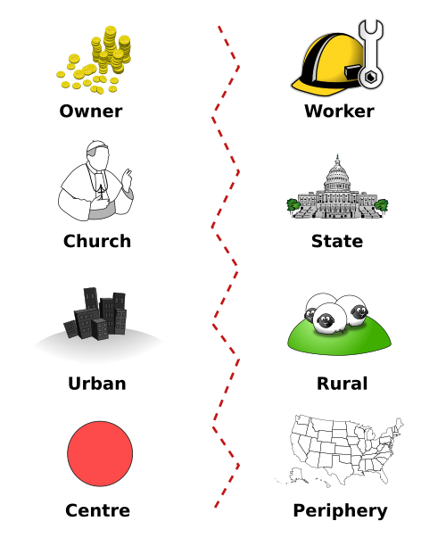
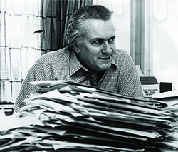
Recap: Cleavages
Stein Rokkan: Objective social differences (class, religion, race, ...) of which there is a subjective awareness (cultures, ideologies, orientiations) & that become locuses of political organisation
Owner
Worker
Church
State
Industry
Rural
Centre
Periphery

Slide 23
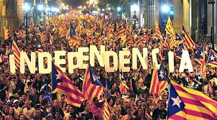

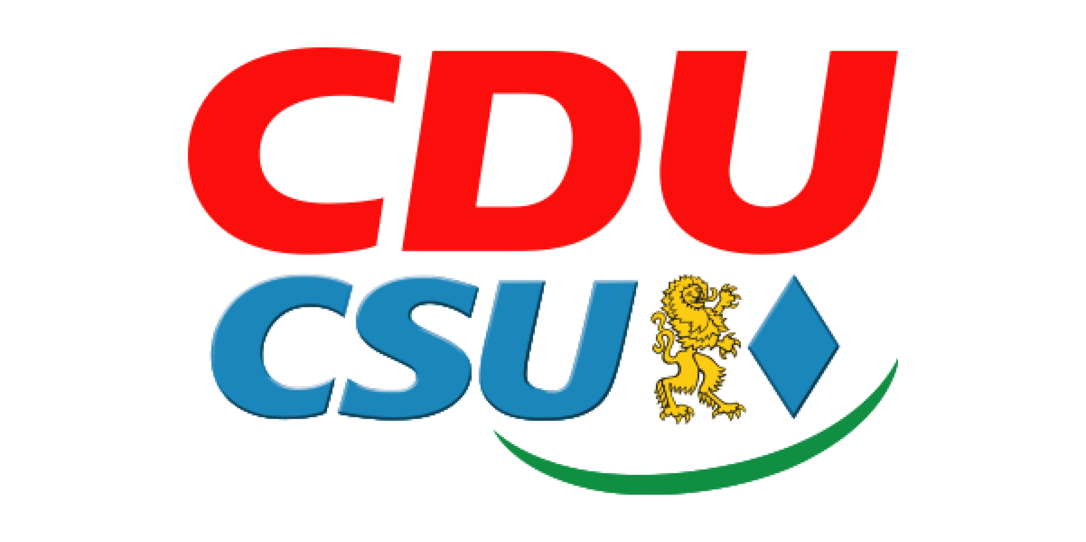
National Revolution
Reformation -> Centre-Periphery
2. French Revolution -> Secular vs. Religious
Christian Democratic/ Social Union
Law and Justice

Slide 24

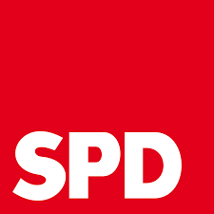
Industrial Revolution
3. Commodity Market -> Urban vs. Rural
4. Labour Market -> Capital vs. Labour
Polish People's Party
Finnish Centre Party
Social Democratic Party of Germany

Slide 25
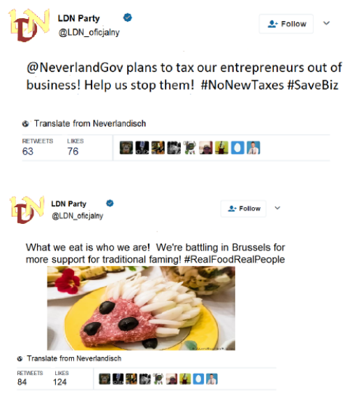
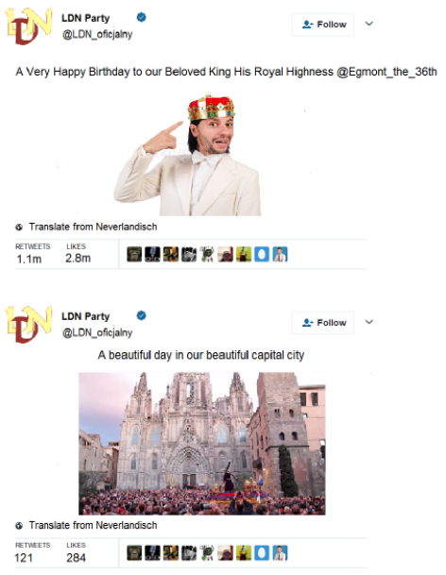
The LDN Party in Neverland

Slide 26
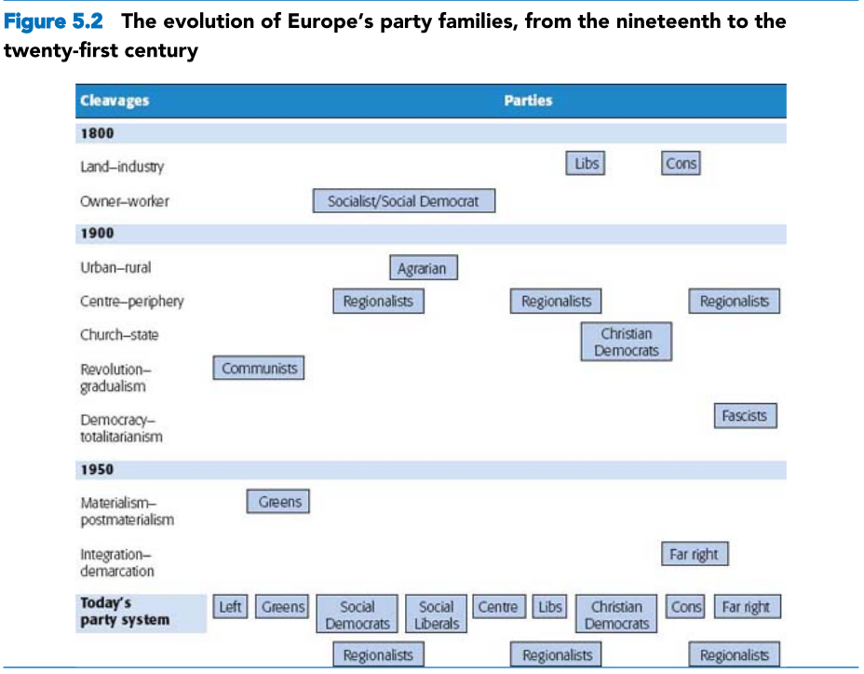
Cleavages & Party System Evolution

Slide 27
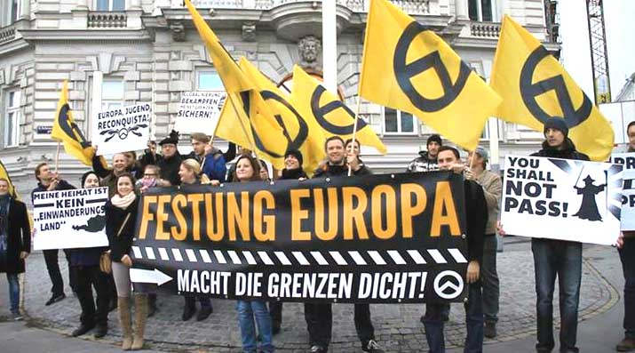

Recap: Transnational Cleavage
Hooghe & Marks:
Political conflict is now value and culture-driven
Triggered by:
Immigration
EU integration
globalization
"Defending national, political, social and economic ways of life against external actors who penetrate the state."

Slide 28
Cleavages & Party System Evolution

Slide 29
Origin of Party systems
Fragmentation?
#Parties
Polarization?
Ideological distance
Electoral System
(Next week)
Cleavages
(Party Families)

Slide 30
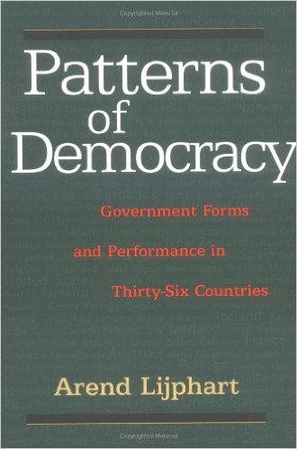
Issue Dimensions and #Parties (Lijphart, 1999)
Two-party systems: left-right
Multiparty systems: multiple issue dimensions
Taagepera & Grofman (1985): N = I + 1
Ireland: historically 2 issue dimensions and around 3 effective parties
But in 2024: 6.5 ENEP & 5.2 ENPP
Effect of electoral system + Party system change

Slide 31
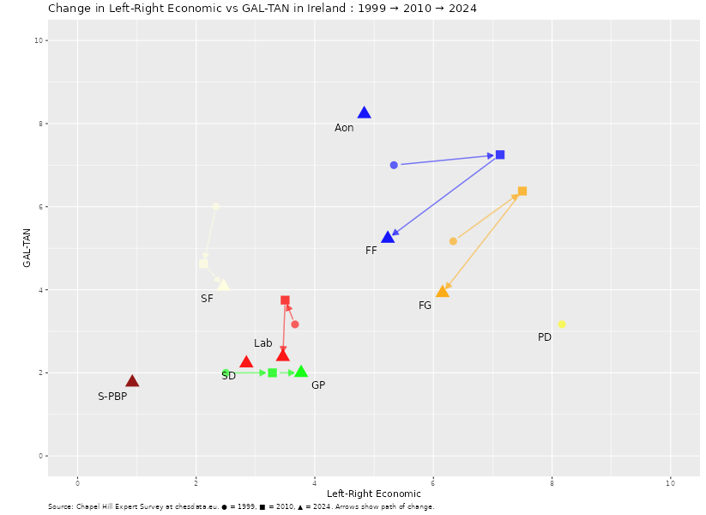
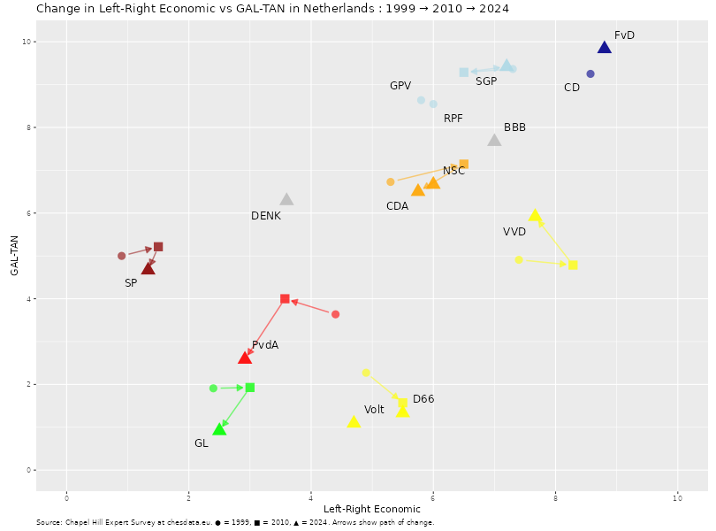
Have party systems changed? Polarization
Ireland
Netherlands
https://www.chesdata.eu/ches-europe

Slide 32
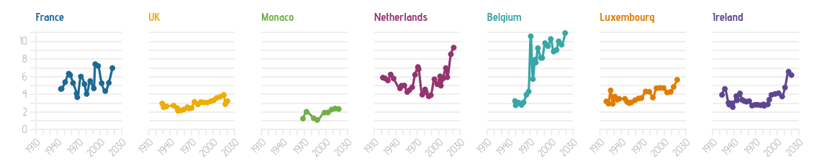
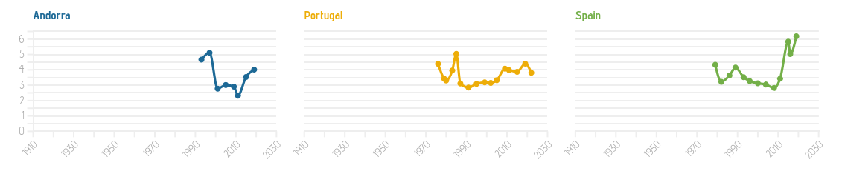
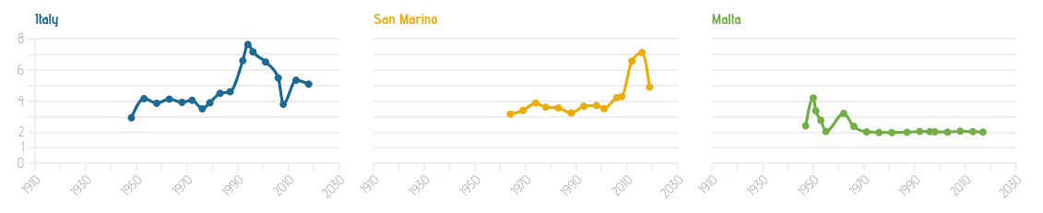
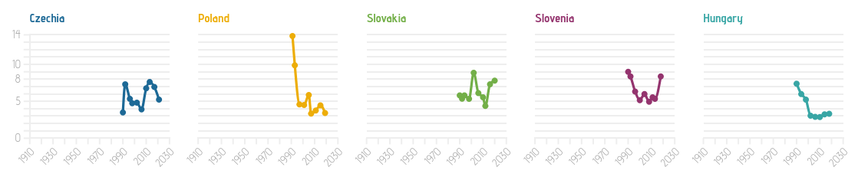
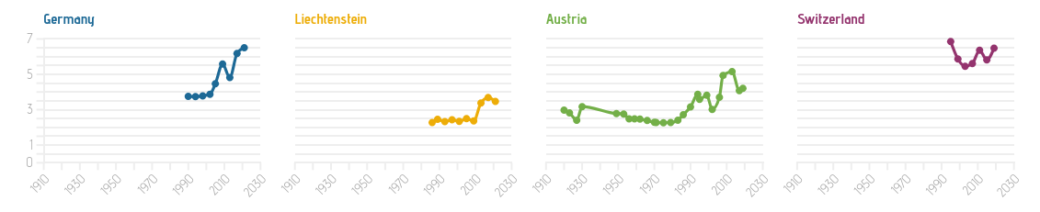
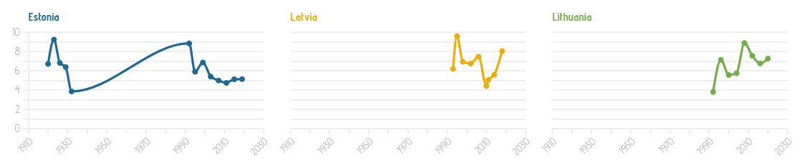
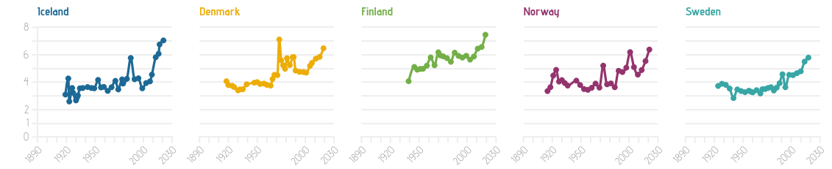
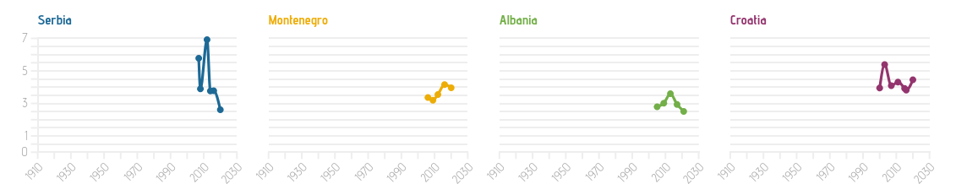
Have Party Systems Changed? Fragmentation
https://europeelects.eu/2022/03/07/fragmentation/

Slide 33
Have party systems changed?
Yes
But
Voters switch between parties more (electoral volatility)
Preferences have become more individual (dealignment)
Parties have seen changes in ideological positioning as cleavages subside and value-driven conflict rises
New parties keep popping up
New parties are not always successful (f.i. flash parties)
Traditional left-right blocs remain consistent
Institutionalism (electoral system, political finance rules, …) keep the status quo largely intact

